Slide 1


Data Science 2A Project (Time Series & Data Mining)
Early Detection & Monitoring
of Atrial Fibrillation Cases
Group 123:
Michael & Pedro da Silva
April 2023

Slide 2

Agenda
Introduction & Motivation
Research Questions
Dataset Background
Methodologies
Results & Discussion
Limitations & Future Studies

Slide 3
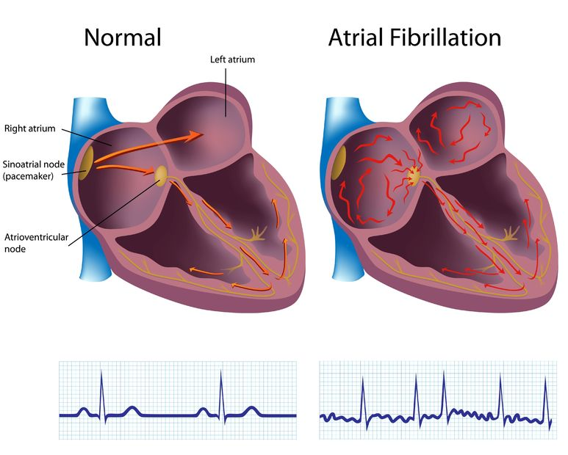
Introduction & Motivation
Atrial Fibrillation (AF) is a type of irregular heartbeat, or arrhythmia, that originates in the upper chambers of the heart (the atria). In AF, the atria beat irregularly and rapidly, which can cause poor blood flow to the body and increase the risk of blood clots, stroke, heart failure, and other cardiovascular complications.
Electrocardiogram (ECG) is capable of capturing the random heartbeat patterns associated with Atrial Fibrillation (AF) episodes. The randomness is reflected by the RR intervals.
Although AF is a common cause of many dangerous cardiovascular complications, it can be very difficult to detect, requiring tedious manual works. AFs are very short in the ECG signals and there are a lot of noises in the signals themselves.
Given the inefficiency and high error rates of manual AF detection, there is a strong demand for an automatic, early AF detection for effective treatment.
RR Interval

Slide 4

Research Questions
The challenge of this project is to develop a predictive model using machine learning algorithms that is capable of automatically detecting episodes of Atrial Fibrillation from ECG data.
Main Research Question:
To what extent can we accurately detect atrial fibrillation using the RR intervals from ECG signals and machine learning techniques?
Sub-Research Question:
What features of ECG signals are most informative for detecting atrial fibrillation?
Which machine learning algorithms are most effective for detecting atrial fibrillation using ECG data?

Slide 5
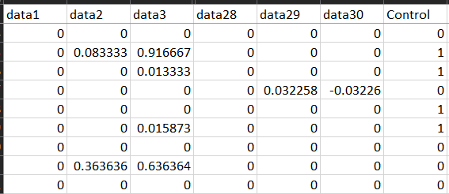
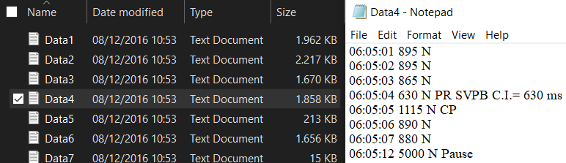
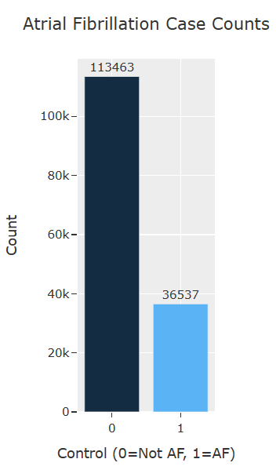
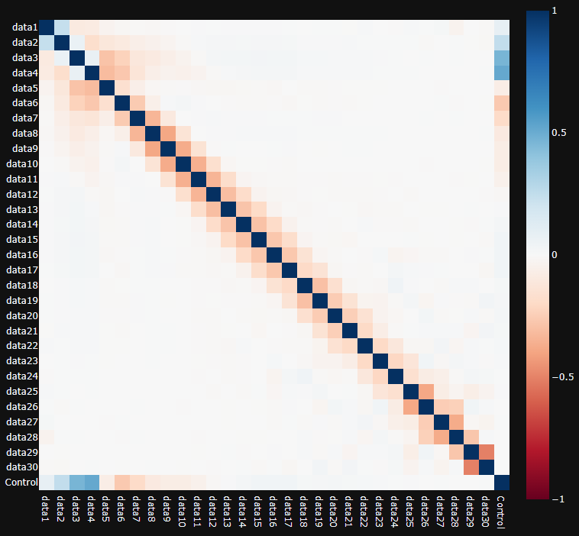
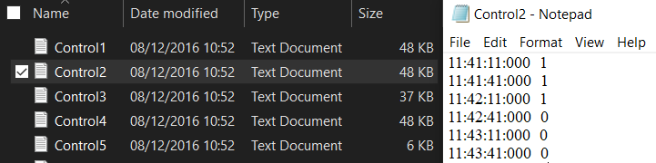
Dataset Background
Raw data
Data Source:
ECG data from the Erasmus Medical Centre in Rotterdam of the department electrophysiology. Data was obtained within 10 days post-operatively of CABG surgery.
ECG Data
804 text files (Data1 to Data804)
A semi-automatic program (Synescope) is used to analyze the ECGs for R peak annotation, followed by manual auditing by a physician to label AF cases.
Preprocessed data
150,000 observations
30 dependent variables (data1, data2, …, data30)
1 independent variable (Control)
Class Data
804 text files (Control1 to Control804)
The AF and no-AF episodes were transformed into 1 and 0 in 30-second intervals by considering if more than 75% of the period was AF.

Slide 6
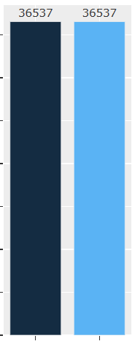
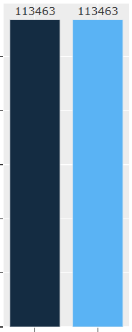
Methodologies
Handle Imbalance
Original
Model Building
Train-test split
Feature scaling
Model training & testing**
Result analysis
Preprocessed
Data
EDA
Undersampling
Oversampling (SMOTE)
Data Preprocessing
Text file transformation
Merge both raw files, sliding windows of 30 seconds & 50% overlap
Data cleaning
Model Building
Handle class imbalance
Train-test split
Feature scaling
Model fitting & predicting**
Result analysis
Feature Engineering
Feature generation*
Handle missing data
Feature selection
Raw Data
EDA
*features: time domain, frequency domain, geometrical, CSI&CVI, poincare plot (refer to the appendix for in-detail feature list)
**models: logistic regression, elastic net, KNN-DTW, naïve bayes, decision tree, random forest, XGboost, ANN, K-means clustering

Slide 7
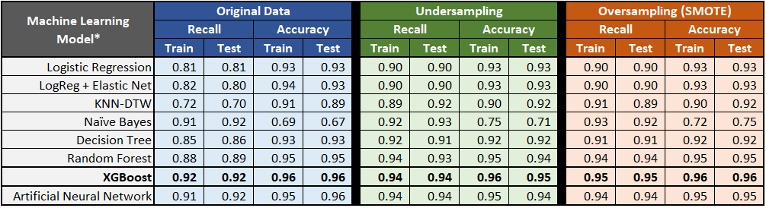
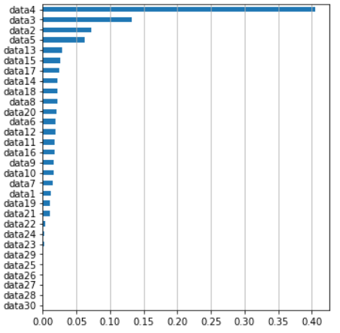
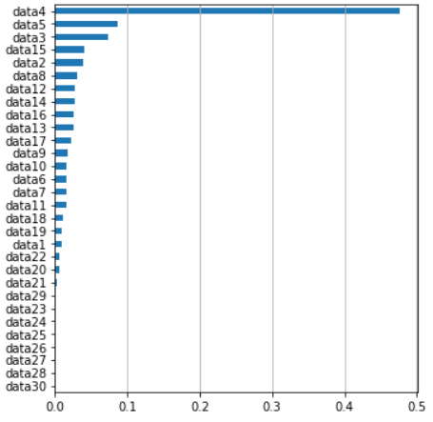
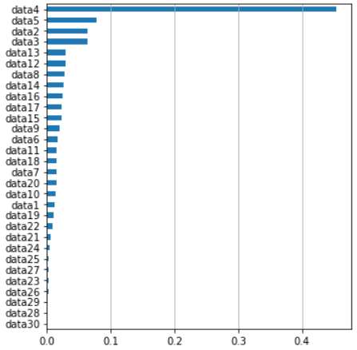
Results & Discussion
Preprocessed Data
Feature Importance
(based on XGBoost Model)
Feature
Importance**
*model hyperparameters are tuned using GridSearch. Cross Validation with 5 folds were implemented for model training & testing
**importance = normalized average gain of each feature in all trees of the XGBoost model, representing the improvement in accuracy when it is used in split

Slide 8
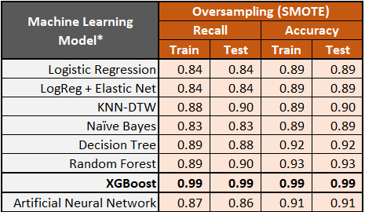
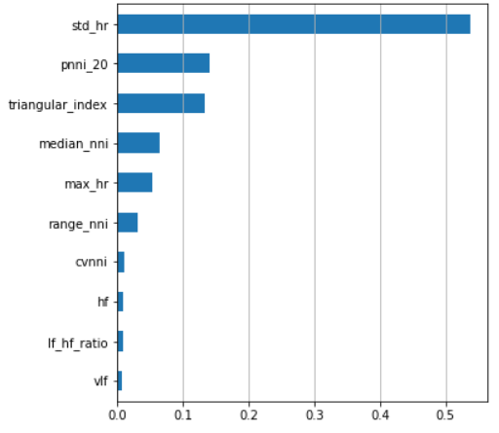
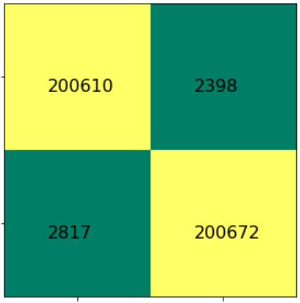
Results & Discussion
Raw Data
Model Result
Confusion Matrix
(XGBoost Model,
test dataset)
Feature Importance
(based on XGBoost Model)
Actual
Not AF (0)
Actual
AF (1)
Predicted
Not AF (0)
Feature
Predicted
AF (1)
Importance**
XGBoost Model has the best recall (0.99) and accuracy (0.99) compared to all models in both train and test datasets.
Time domain features (std_hr, pnni_20, median_nni) have higher feature importance than frequency domain features (hf, lf_hf_ratio, vlf)
Unsupervised learning: Tried K-means clustering with no success validating the data
*model hyperparameters are tuned using GridSearch. Cross Validation with 5 folds were implemented for model training & testing
**importance = normalized average gain of each feature in all trees of the XGBoost model, representing the improvement in accuracy when it is used in split

Slide 9

Limitations & Future Studies
Limited domain knowledge and information about the data collection process. Expertise in signal filtering is required, and more time should be invested in this step to extract better Heart Rate Variability features.
Availability of computational resources, particularly in computationally expensive algorithms such as KNN-DTW, resulting in the use of only 25% of the raw data (200 out of 804 files) for model training.
More input data from patients, using RR intervals is only one of the methods to detect Atrial Fibrillation
Data quality, validity and standards of the dataset came into check during the development of the testing models
Deep learning techniques exploration for AF detection from ECG signals, which may improve the accuracy and efficiency of the detection process.
Shorter window size in AF labeling, as 30 seconds might be too long to detect AF signals. It might also reduce class imbalance in the pre-processing part.

Slide 10

Thank you! Questions?

Slide 11
Raw Data Feature List (1/2)
Feature Type | Feature Name | Description
Time domain | mean_nni | The average of all RR-intervals in a given period of time
 | sdnn | The standard deviation of all RR-intervals in a given period of time
 | sdsd | The standard deviation of differences between adjacent RR-intervals in a given period of time
 | nni_50 | The number of pairs of adjacent RR-intervals that differ by more than 50 ms in a given period of time
 | pnni_50 | The percentage of pairs of adjacent RR-intervals that differ by more than 50 ms in a given period of time
 | nni_20 | The number of pairs of adjacent RR-intervals that differ by more than 20 ms in a given period of time
 | pnni_20 | The percentage of pairs of adjacent RR-intervals that differ by more than 20 ms in a given period of time
 | rmssd | The square root of the mean of the squared differences between adjacent RR-intervals in a given period of time
 | median_nni | The median of all RR-intervals in a given period of time
 | range_nni | The difference between the maximum and minimum RR-intervals in a given period of time
 | cvsd | The coefficient of variation of differences between adjacent RR-intervals in a given period of time
 | cvnni | The coefficient of variation of all RR-intervals in a given period of time
 | mean_hr | The average heart rate calculated from the RR-intervals in a given period of time
 | max_hr | The maximum heart rate calculated from the RR-intervals in a given period of time
 | min_hr | The minimum heart rate calculated from the RR-intervals in a given period of time
 | std_hr | The standard deviation of the heart rate calculated from the RR-intervals in a given period of time

Slide 12
Raw Data Feature List (2/2)
Feature Type | Feature Name | Description
Frequency domain | vlf | the spectral power in the frequency range of 0.0033 to 0.04 Hz
 | lf | the spectral power in the frequency range of 0.04 to 0.15 Hz
 | hf | the spectral power in the frequency range of 0.15 to 0.4 Hz
 | lf_hf_ratio | the ratio of the power in the LF band to the power in the HF band
 | lfnu | the normalized units of the LF component, expressed as a percentage of the total power minus the VLF power
 | hfnu | the normalized units of the HF component, expressed as a percentage of the total power minus the VLF power
 | total_power | the sum of spectral power across all frequency bands (VLF, LF, and HF)
Geometrical | triangular_index | the width of the distribution of RR intervals, calculated as the number of RR intervals divided by the height of the histogram's mode
 | tinn | the estimated width of the distribution of RR intervals by calculating the time between the first and last of three equidistant points along the histogram of RR intervals
CSI & CVI | csi | (Complex Systems Instability): This is a non-linear measure of the complex interactions between different physiological systems, such as the cardiovascular and respiratory systems. It is calculated as the ratio of the power in the high-frequency (HF) range (0.15-0.4 Hz) to the power in the low-frequency (LF) range (0.04-0.15 Hz) of the heart rate variability spectrum.
 | cvi | (Composite Variability Index): This is a measure of the overall variability in the heart rate over time. It is calculated as the ratio of the standard deviation of the normal-to-normal intervals (SDNN) to the mean heart rate.
 | Modified_csi | An enhanced version of the original CSI that includes a correction for respiratory sinus arrhythmia, which is a natural variation in heart rate that occurs with breathing. It is calculated as the ratio of the power in the high-frequency range (0.15-0.4 Hz) to the power in the low-frequency range (0.04-0.15 Hz) after correcting for respiratory sinus arrhythmia.
Poincare plot | sd1 | a measure of the short-term variability of beat-to-beat intervals
 | sd2 | a measure of the long-term variability of beat-to-beat intervals
 | ratio_sd2_sd1 | the ratio of sd2 to sd1, which provides an index of the balance between sympathetic and parasympathetic activity

Slide 13
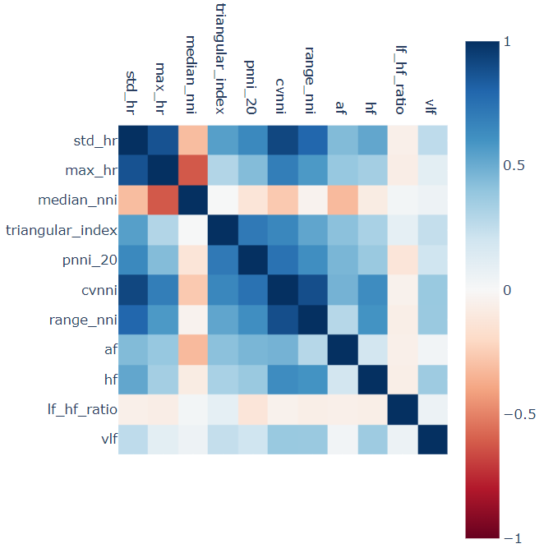
Raw Data Feature Correlation

